Slide 1

Air BNB
GROUP B2
TREDENCE ANALYTICS

Slide 2

ABOUT THE AIRBNB DATASET
Airbnb, Inc. is an American vacation rental online marketplace company based in San Francisco, California, United States
Airbnb offers arrangement for lodging, primarily homestays, or tourism experiences
The data centers around the Home rentals in the city of New York from the period of 2008-2015
This dataset consists Of 30479 rows and 13 columns
ROWS— It consists of the host ID and the details about the host and his/her property with customer ratings
COLUMNS—It consists of several categories which highlights the stay's specifications

Slide 3

COMPLETE PROBLEM STATEMENT
Airbnb wants to extend its service by giving feedback to the owners or hosts on how they can improve their services.

Slide 4
PROJECT WORKFLOW
RAW DATA
PRE-PROCESSING
ANALYSIS
Data was in an excel worksheet with 30478 rows and 13 columns.
Data cleaning was necessary. After treating the values, the final dataset consists of 30387 rows and 13 columns.
Finally, Excel, PowerBI, and Tableau tools were used to solve our business problem and gain insights for the betterment.

Slide 5



team
EXCEL
POWERBI
TABLEAU
Pranjali Kumbhare
Zafar Imam
Biswajeet Mandal
Aashish Jain
Ashish Kumar
Ashish Kumar Gaurav
Akshan Mairal
Vinit Sudhir Hule
Kumar Aryan
Piyush Kumar

Slide 6

KEY FINDINGS
Manhattan is the most expensive neighborhood.
The maximum number of beds are found to be in apartments and houses.
Manhattan has the maximum average price of beds and Bronx has the least average price compared to others.
After the year 2009 Airbnb covered two new neighborhoods (Bronx and Staten Island) which explains the Success and expansion Of Airbnb.
Also, Airbnb has grown each year with respect to Customers and hosts until the year 2015 in which they faced a setback.
Price depends on reviews, location as well as number of beds.
Apartment is the most used property among all.
Since 2008 was a year when Airbnb started, many locations did not have access to several facilities in terms of property type most of the property were either apartments or houses.
Since reviews give a better picture about the quality of the stay, the price range does depend upon the number of reviews.

Slide 7
INSIGHTS From Data - Excel

Slide 8
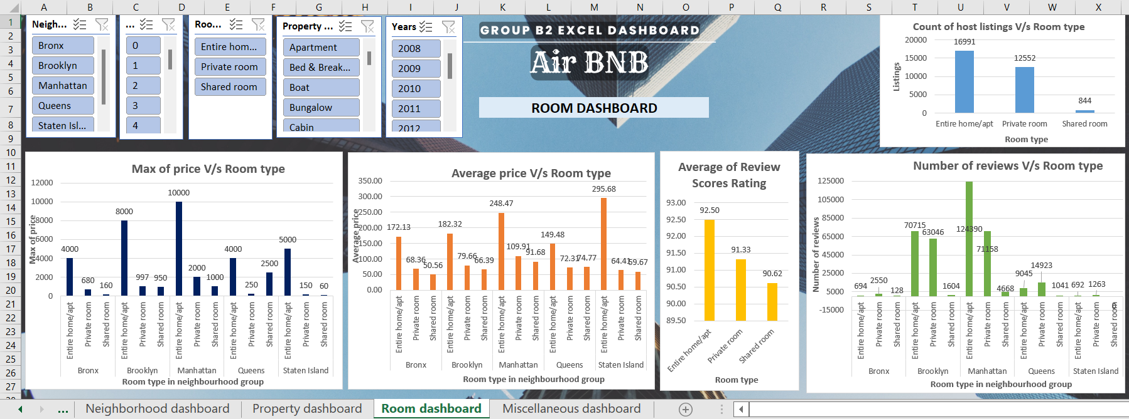
INSIGHTS From Data - Excel
Choose Filters to select Property type, Neighborhood, Year, Room type and number of beds based on your preference
Choose from different dashboards to get your relevant insights
Data clearly visible to get the attribute and related numeric values

Slide 9
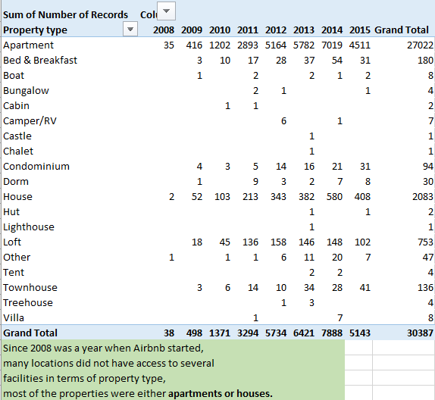
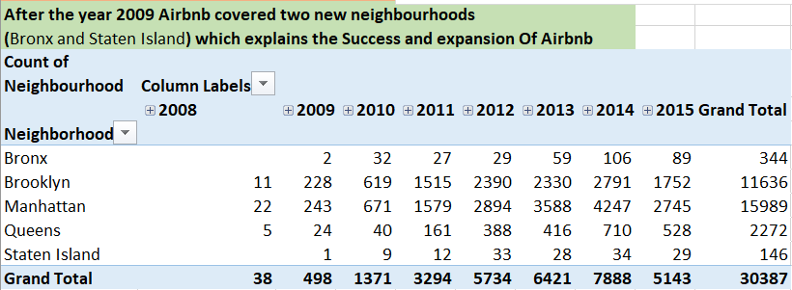
INSIGHTS From Data - Excel

Slide 10
INSIGHTS From Data - Excel

Slide 11
INSIGHTS From Data - Excel

Slide 12
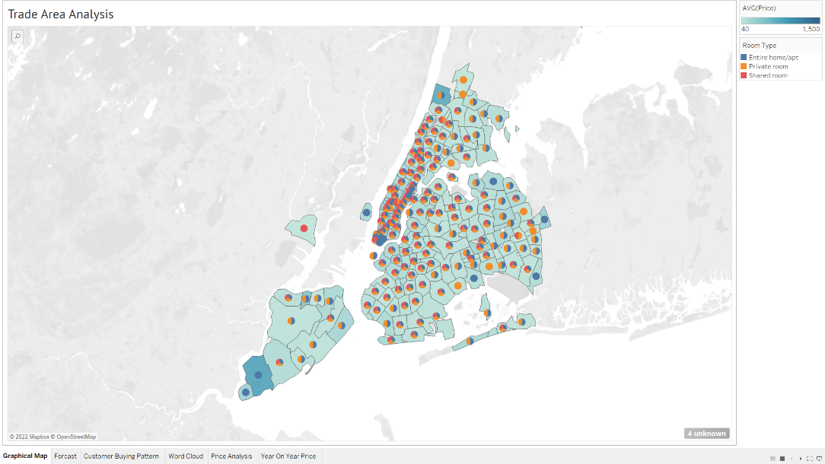
INSIGHTS From Data – Tableau
Trade Area Analysis of AirBnB
Pie Chart of Room Type
Min Average Price - 40
Zip code – 94103
Room Type - Shared Room
Max Average Price - 850
Zip code – 10309
Room Type - Entire Home/Apt

Slide 13
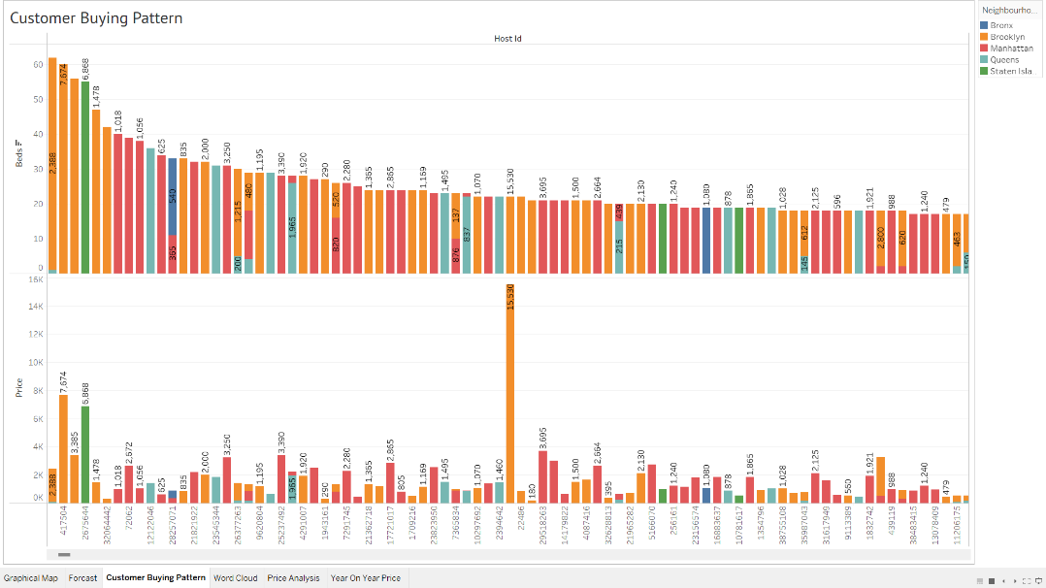
INSIGHTS From Data - Tableau
Customer Buying Pattern
Neighbourhood – Brooklyn
Host ID- 35927005
Sum Total Beds – 61
Neighbourhood – Brooklyn
Host ID- 1177497
Sum Total Price – 15530

Slide 14
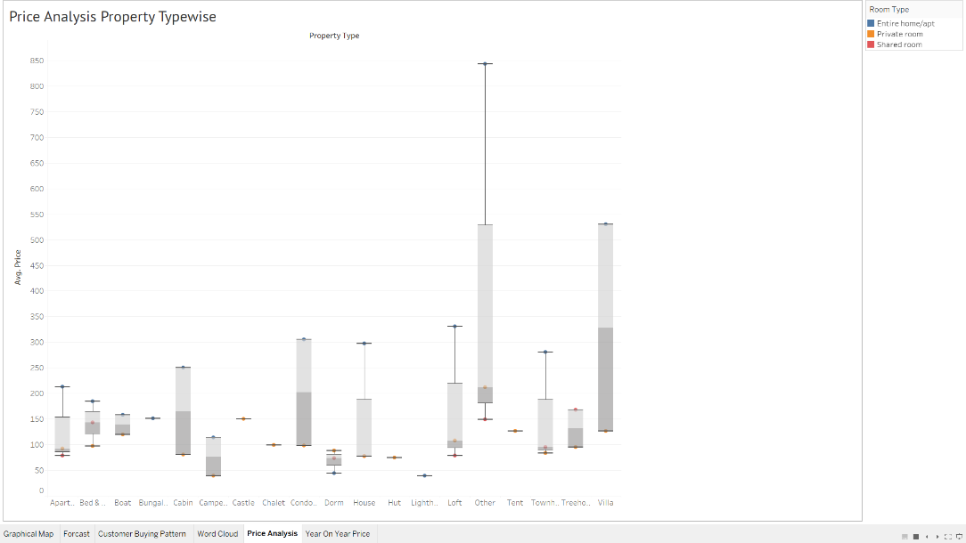
INSIGHTS From Data - Tableau
Box Plot → Price Analysis
Others
Max Value – 834.4 ( Entire Room Apt )
Min Value – 148.8 ( Shared Room )
Median – 211.9 ( Private Room )
Interquartile range
IQR

Slide 15
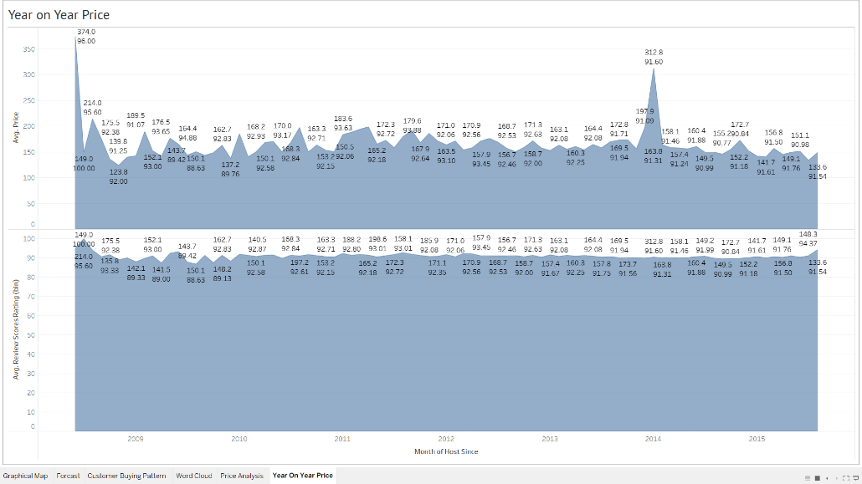
INSIGHTS From Data - Tableau
Area Chart – Comparison of Year on Year Price & Reviews
June & July 2008 being the Best months
June & July 2008 being the Best months

Slide 16
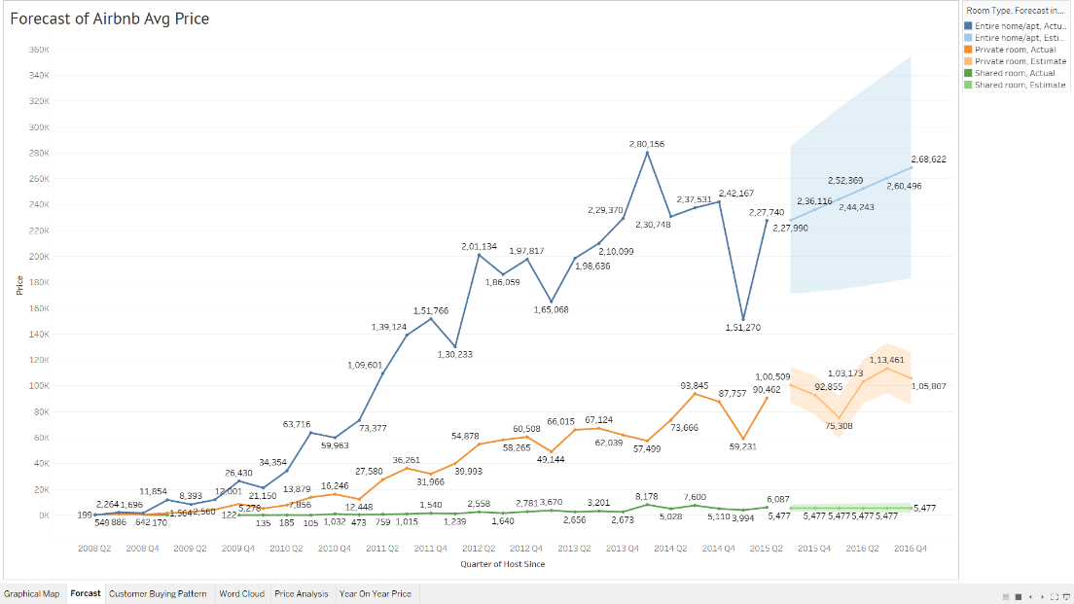
INSIGHTS From Data - Tableau
Forecast of Air BnB Price on
Q-Q Basis
Highest Price – 280156
Avg Price – 313.7
Quarters - 2014Q1
Room Type – Entire Home/Apt
Entire Home Estimate
Private Room Estimate
Shared Room Estimate

Slide 17
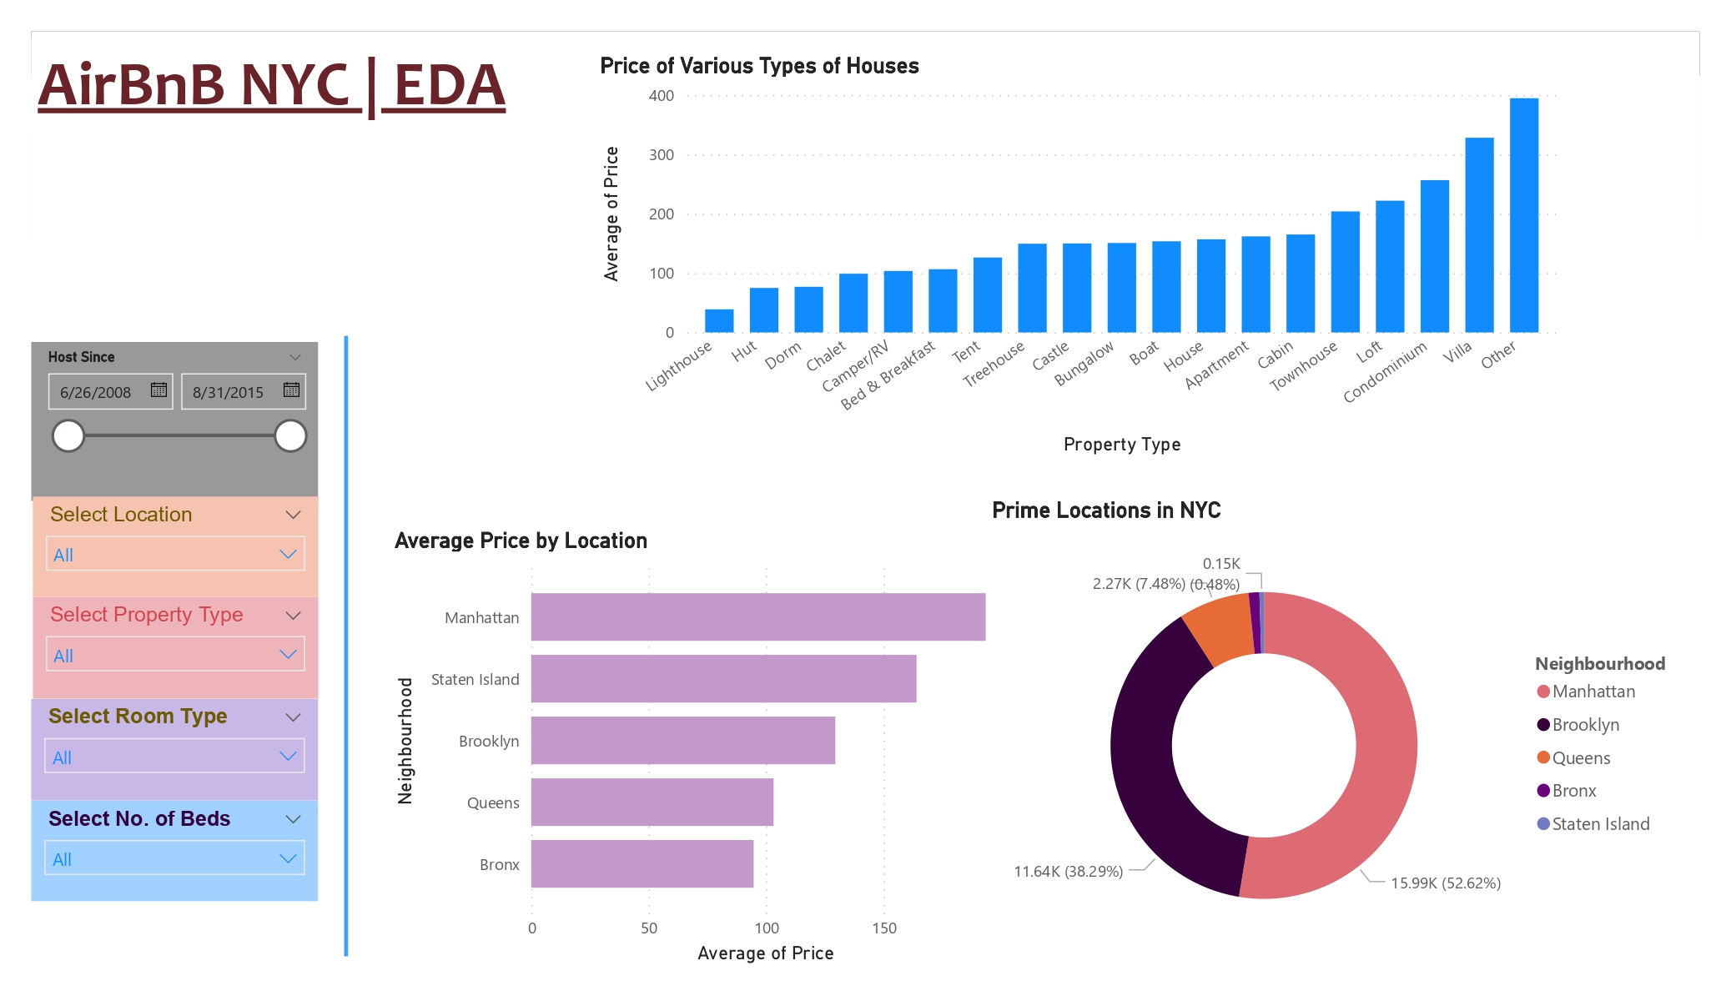
INSIGHTS From Data - PowerBI
Huts and Dorms are budget friendly to stay
Choose Filters to select property type based on your preference

Slide 18
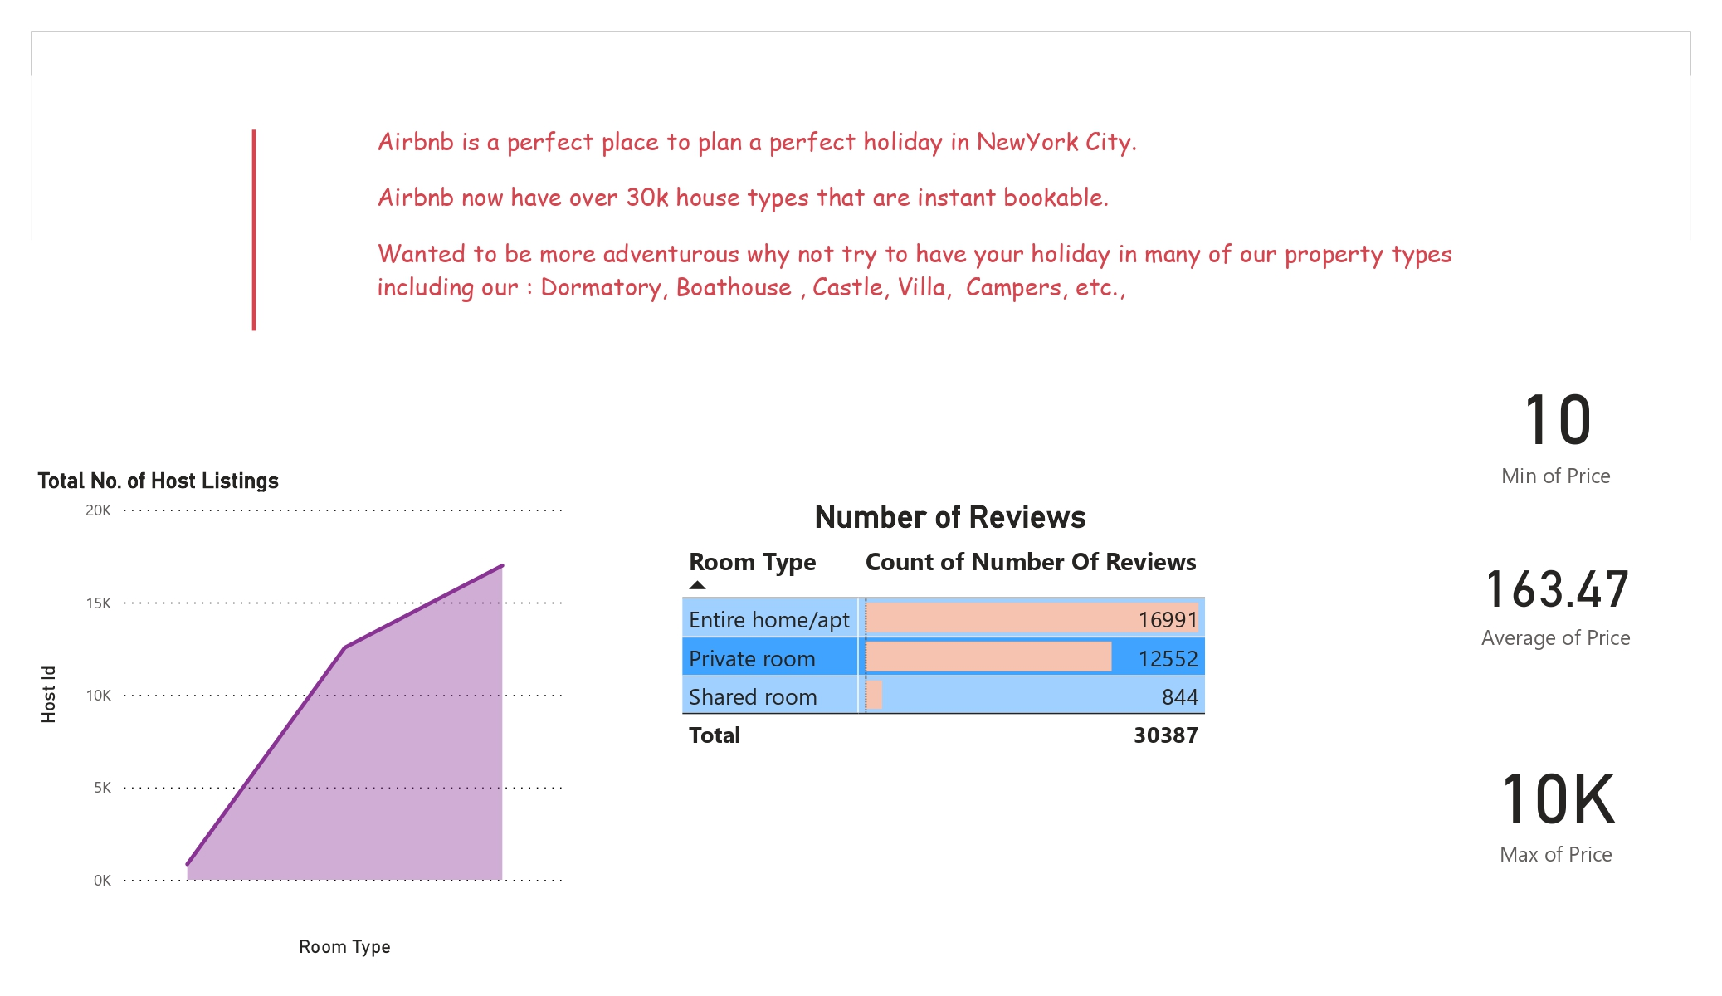
INSIGHTS From Data - PowerBI
Price Metric shows that the properties are available from a wide range of Budget Friendly rooms to Luxurious Villas at a whooping price.

Slide 19
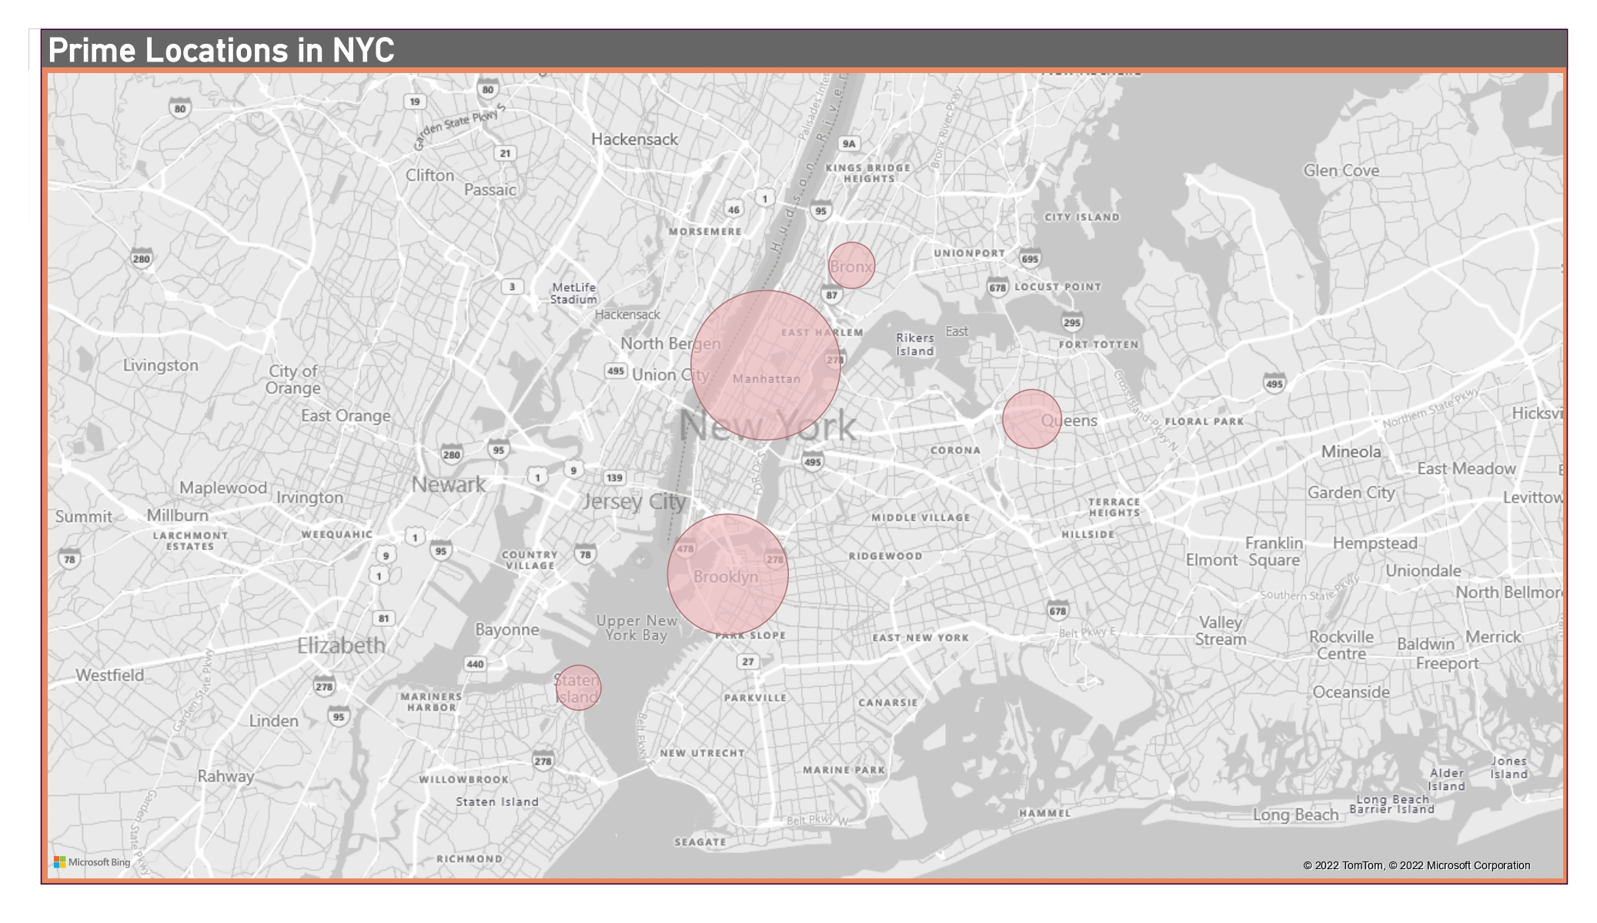
Analysis : PowerBI
Bubbles Indicating the Prime Offerings in NYC
Manhattan has the largest no. of properties.
Bubbles Indicating the Prime Offerings in NYC
Manhattan has the largest no. of properties.

Slide 20
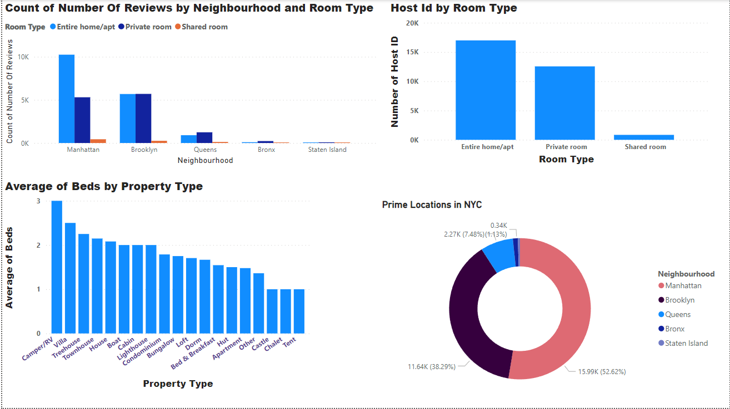
INSIGHTS From Data - PowerBI
CALLOUTS
On the basis number reviews and order of bookings, the Prime location MANHATTAN.
Where large number of room type are Entire home/apt.
As per requirement we can see the average number of beds for number of available people. Which is hold by Camper/RV and Villa type property.

Slide 21
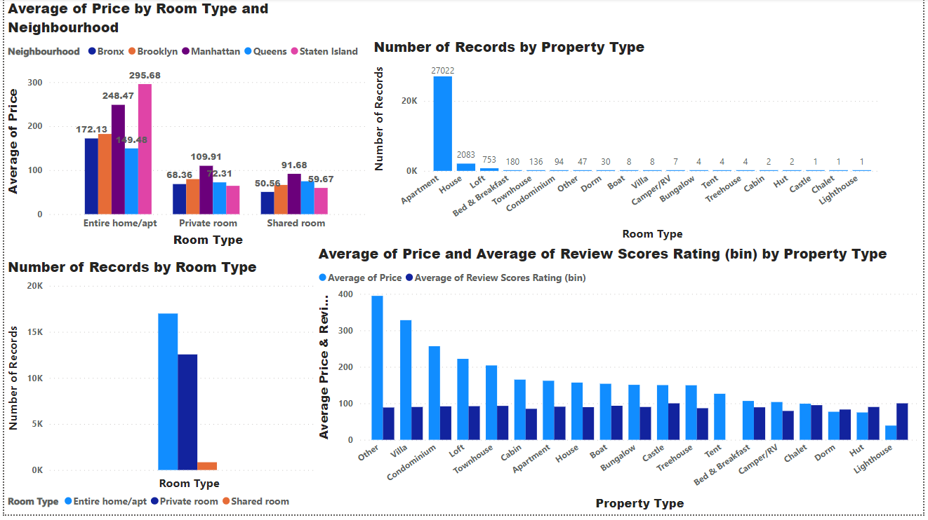
INSIGHTS From Data - PowerBI
CALLOUTS: AFFORDABILITY
Based on previous report, it is clear to see in Manhattan there is average pricing for Entire home/apt =248.47, and in Brooklyn it is High.
As per records the “APPARTMENT” type property is mostly used .
We can find out which type of property going to help customer for bookings and average price and rating given by users Apartment, House, Boat, Castle, Townhouse would be the most affordable options.

Slide 22

Thank you!

